Slide 1
Homeless liaison program (The hlp team)

Slide 2
mission
-
Santa Monica Police Department Homeless Liaison Program – “The HLP Team”
-HLP has been around for 20+ years
HLP Team comprised of 1 Sergeant, 8 Officers, and 1 DMH clinician
-Address chronic and problematic high utilizers (police and fire services) and hot spots throughout the city.
-Utilize the tools available (enforcement, DMH, homeless services, advocacy) to help those who are either unable or unwilling to accept help.
-Collaborative Approach: City Attorney’s office / Health & Human Services / DMH / Local outreach teams and various service providers
*Goal for the team à Mitigate the impact homelessness has on our city.

Slide 3
City of santa monica’s 4 pillars strategy
Preventing housed Santa Monica residents from becoming homeless; increase affordable housing
Address behavioral health needs of vulnerable residents
Maintaining equitable access to open spaces
Strengthen regional capacity to address homelessness

Slide 5
LOS ANGELES COUNTY SERVICE PLANNING AREAS

Slide 7
Homeless in the u.s. (2023)

Slide 8
Homeless engagement

Slide 9
Graduated enforcement model to change behavior
Advise of offenses
Referral to appropriate services
Coordinated outreach efforts with HSD and service providers
Citations if behavior continues
Continued push towards appropriate services
Coordinated outreach efforts
Arrest if behavior continues
Coordinate with CAO & HSD for better outcomes with services
Stay Away Orders
Refer to appropriate services
Refer to appropriate services

Slide 10
TRIAGE QUESTIONS
How long have you been homeless in Santa Monica?
Where were you last permanently housed?
Are you a veteran?
Where are you receiving services?

Slide 11
Santa Monica program participants (smpp)
Individuals that have been documented as homeless in Santa Monica for five or more years
Individuals who are homeless and whose last permanent address was in Santa Monica
Santa Monica’s workforce who became homeless
High Utilizers of Police and Fire Department services

Slide 12
How we use the TRIAGE information
Refer to appropriate services by determining
If SMPP city funded outreach / service providers
Not SMPP connected to other outreach / service providers
New to SM refer to WCC for family reunification
Veterans reconnected to VA
DMH evals and referrals to services for mentally ill
Identify if High Utilizer of City resources (HUG LIST)

Slide 13
Social services
Family Reunification: The People Concern, West Coast Care, and Salvation Army
Basic Local Services: The People Concern (TPC), Step Up on Second St., The Salvation Army
Regional Services: Saint Joseph’s Center – County resource, available to all homeless individuals in LA County
Youth Services SPY – Safe Place for Youth in Venice
Mental Health: Dept. Mental Health, Exodus Recovery Urgent Care and Step Up on Second St.
Substance Abuse Treatment: CLARE Matrix
Veterans: Veterans Administration
Cash Aid: DPSS Office at 11110 W. Pico Blvd., GR money, food stamps, etc.
Employment Services: Chrysalis

Slide 14
Street Outreach Teams Multidisciplinary teams
C3 (County, City, Community)
City funded team
Citywide outreach as of 2023*
HMST (Homeless Multidisciplinary Street Team)
Focus on top 25 highest utilizers of police & fire services
St. Joseph Center
Lead SPA 5 Agency
Oversees E6 team
Salvation Army
City-wide outreach team connecting to alcohol/substance abuse treatment centers / VA assistance / short-term shelters
Contract with SMPD*
Therapeutic Transport Van (DMH)
Specialized team that can increase access & quality of mental health services to underserved groups
Subjects must be medically stable, cooperative, and non-combative

Slide 15
Park Closure 4.55.120 SMMC - advisal not necessary but recommended
Civic Center Closure 4.08.094(a)SMMC
Posted Doorway 4.08.097(a)SMMC - advisal not necessary but recommended
Destruction of park foliage 4.55.040 SMMC
Tent in the Park 4.55.060 SMMC
Tent on the Beach 4.55.240 SMMC
Loitering Under the Pier 3.36.100 SMMC
Blocking park path, sidewalk, facility 4.55.050 SMMC
Obstruct a public sidewalk 3.12.360(c) SMMC

Slide 16
Common violations

Slide 17
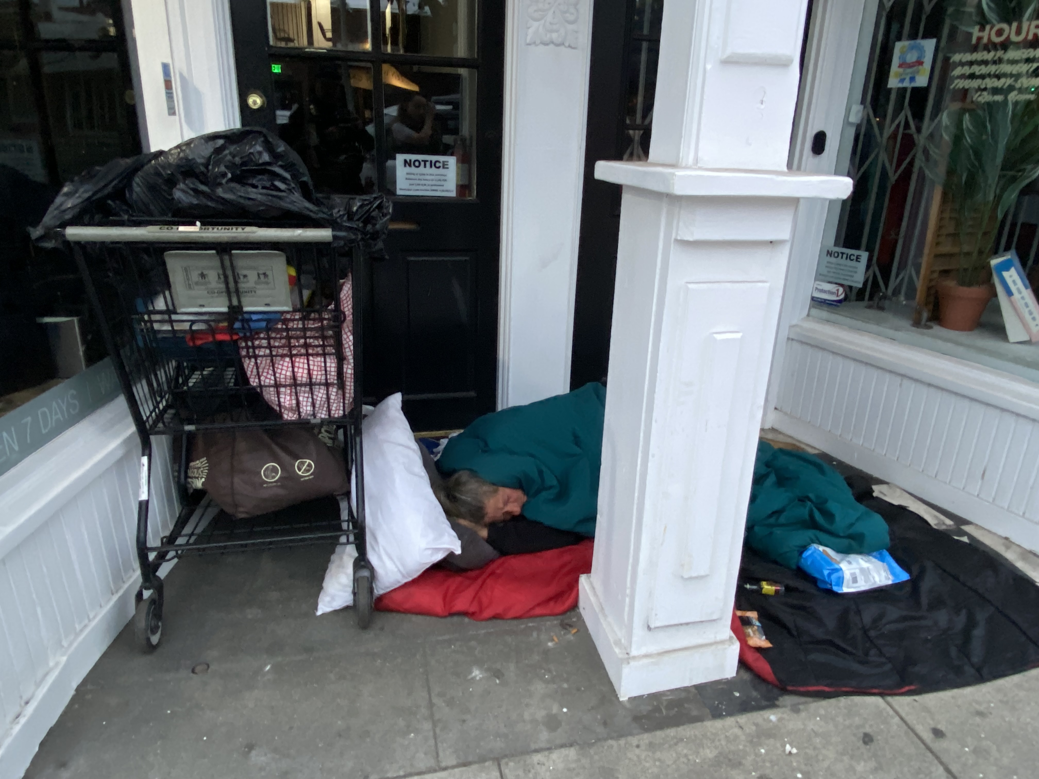
Doorway Violations

Slide 18
Doorway violation
(1) “Downtown” the west side of Ocean Avenue, the north side of Wilshire Boulevard, the east side of Lincoln Boulevard, and the south side of Pico Boulevard.
(2) “Main Street area” the west side of Neilsen Way, the north side of Pico Boulevard, the east side of Main Street from Pico Boulevard to Strand Street, the north side of Strand Street to Second Street, the east side of Second Street and the City’s southern border.
EXPANDED AREAS
(3) “Broadway” the area bounded by the west side of Ocean Avenue and the City’s eastern border.
(4) “Colorado Avenue” the area bounded by the west side of Ocean Avenue and the City’s eastern border.
(5) “Lincoln Boulevard” the area bounded by the north side of Wilshire Blvd. and the City’s southern border.
(6) “Pico Boulevard” the area bounded by the west side of Ocean Avenue and the City’s eastern border.
(7) “Santa Monica Boulevard” the area bounded by the west side of Ocean Avenue and the City’s eastern border.
(8) “Wilshire Boulevard” the area bounded by the west side of Ocean Avenue to the City’s eastern border.

Slide 19
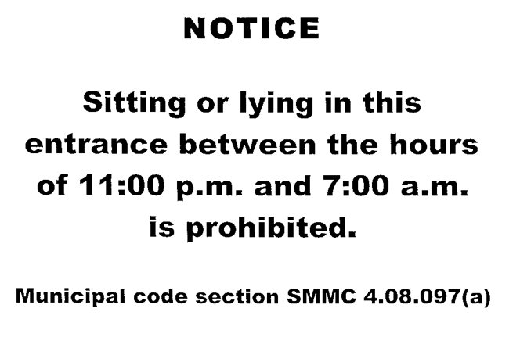

Slide 21
Trespassing / stay away orders
Trespass Arrest Authorization
As of 2024 – request can be made for up to one year.
Must be a notarized request on SMPD form.
Only valid during closed hours and when the responsible is not present
Stay Away Orders
Must have court adjudication and adjudication issued as condition of probation
Good for 1 year
Ex. “Stay Away 100 yds from location”
Must advise prior to citation or arrest
Requested at the end of reports for chronic homeless individuals causing multiple radio calls
Form can be downloaded and then submitted online

Slide 22
Trespass arrest authorization FORM

Slide 23
PUBLIC CAMPING - CASE LAW
Martin v. City of Boise (ID) (9th Circuit)(2018)
8th Amendment violation to enforce camping ordinances without first being able to provide shelter for those experiencing homelessness
Johnson, et al. v. City of Grant’s Pass (OR) (9th Circuit)(2022)
Cannot criminalize having basic rudimentary items including a blanket or a bed roll
Removed certain wording in the SM statute to comply with this ruling
2024 SCOTUS decision (Overturning Boise and Grant’s Pass)
Several states and cities appealed Grants Pass to the Supreme Court.
Not an 8th amendment violation for a city to enforce an encampment ordinance. Reaffirmed the authority of local governments to regulate public spaces. Not required to provide shelter before enforcement*

Slide 24
City Council decides to...
After SCOTUS, the City Attorney was tasked with providing a legal opinion to the City Council.
CAO provided 3 options
Do nothing / Pre-Grants Pass version / Do something new
City Council chose to change the encampment ordinance back to it’s Pre-Grants Pass version.
Changes were effective October 2024

Slide 25
Public camping
4.08.095(a) SMMC No person shall camp in a prohibited public place.
(b) For the purpose of this Section:
“Camp” means to erect, maintain or occupy a camp facility for the purpose of living accommodations. Sleeping is not an element of camping
“Prohibited public facility” means a combination of the following: tents, huts, other temporary physical shelters, cots, beds, sleeping bags, blankets, pillows, hammocks, or bedrolls.
Three elements must be established in every case:
a “camp facility” has been erected, maintained, or occupied
2. “for the purpose of living accommodations”
3. “prohibited public place.”

Slide 27
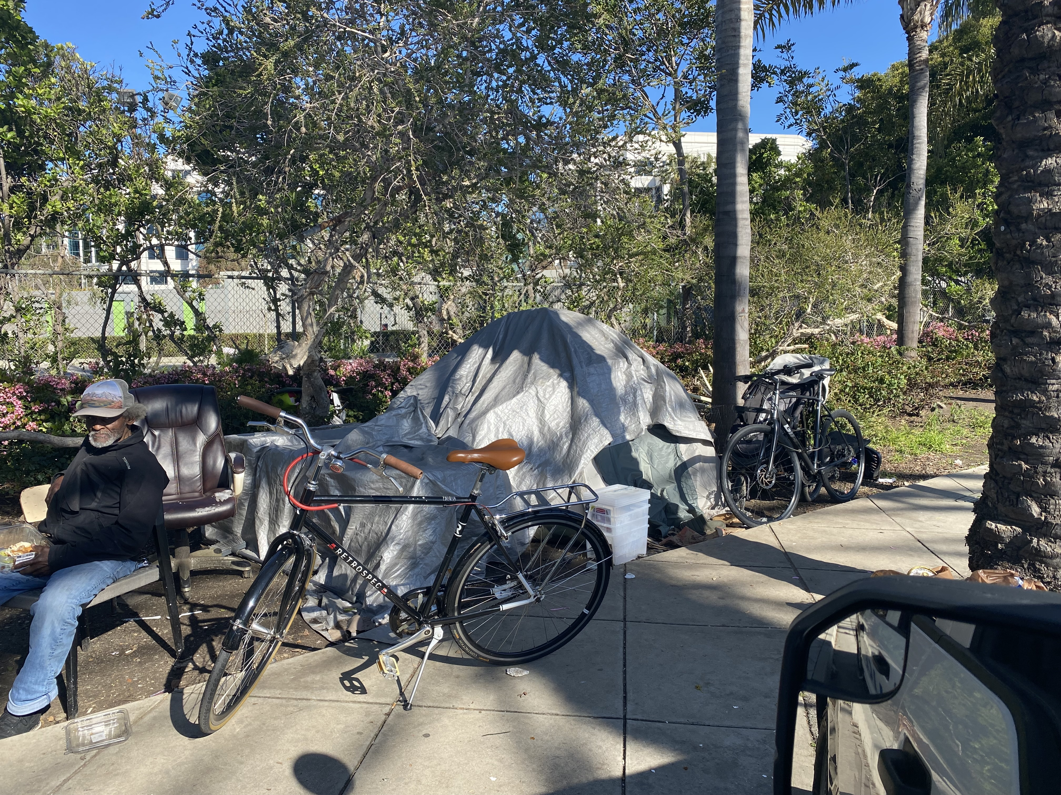
Violation?

Slide 28
Violation?

Slide 29
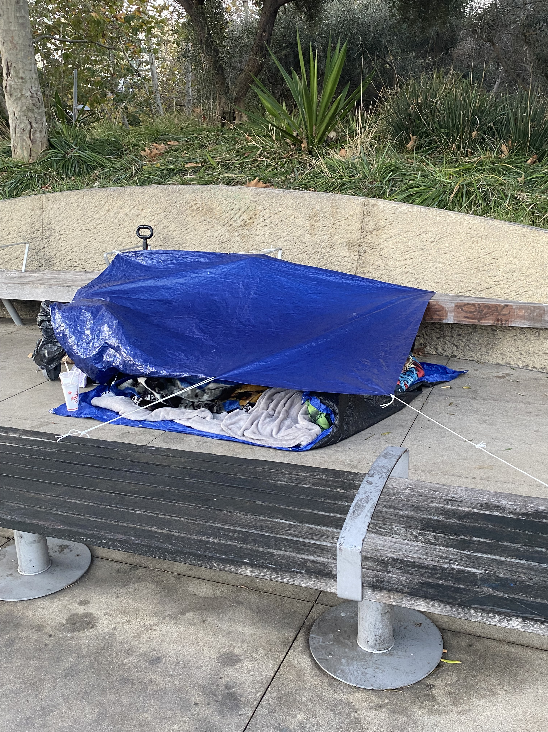
Violation?

Slide 32
City Diversion Programs
*Alternatives to Incarceration (ATI)
LA County Department of Alternatives to Incarceration Pre-filing diversion program
Run by CAO in collaboration with HLP Team implementation
*STEP Court (Shelter/Treatment & Empowerment Program)
STEP Court is a community-based, prosecutor-led collaborative diversion court that focuses on resources rather than criminalization, aiming to streamline connection to social services, address recidivism and ultimately reduce the number of individuals experiencing homelessness in Santa Monica.
Run by the City Attorney's Office
Participants eligible to have citations/warrants dismissed if they connect to services (ATI).
HLP Team plays a role with STEP court.

Slide 33
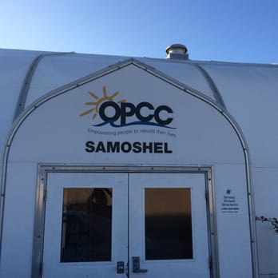
SAMOSHEL REFERRALS
Transitional housing facility. 60 beds. Run by The People Concern nonprofit.
2023 – City of Santa Monica funds the facility 100%
For the first time first responders can make referrals*
2024 – SAMOSHEL now accepts 24/7 referrals from.
As of 9/4/24 the HLP Team year to date has made 26 referrals. Several have since been transitioned into long term housing*

Slide 34
Crisis response

Slide 35
DMH / SMPD Mental HEALTH Evaluation Team
Co-response model - Law Enforcement partnered with DMH LCSW (2 clinicians - HLP Team/Patrol)
Ability to place individuals experiencing mental health emergencies on 5150 holds
Referrals to DMH programs/specialized units
2023 stats:
189 crisis evaluations
115 involuntary hospitalizations 5150WIC
727 homeless contacts
296 referrals to appropriate services

Slide 36
311 Requests
City's general service request system
HLP Team linked to the system starting in 2023
1,015 311 requests handled by the HLP Team in 2023

Slide 37
Questions?

